Slide 1
Predicting Deer Age via Computer Vision
9/25/2025

Slide 2
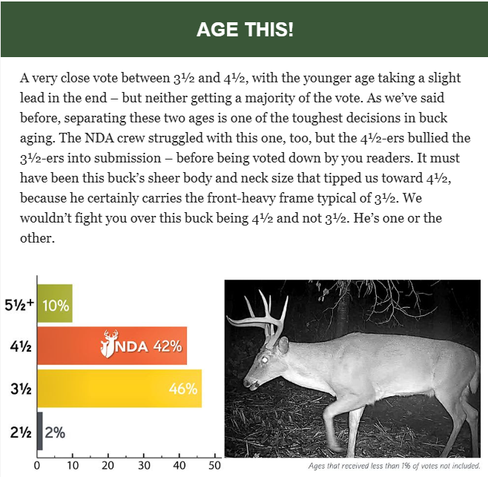
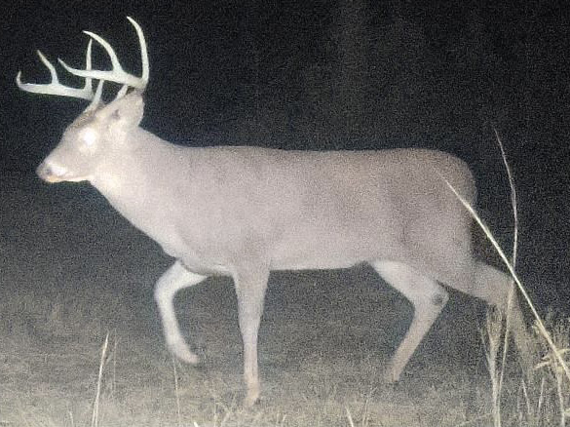
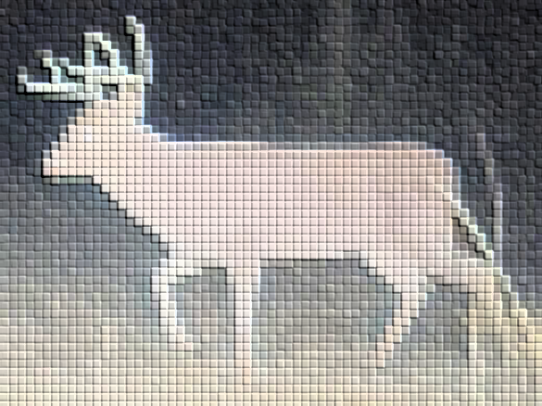

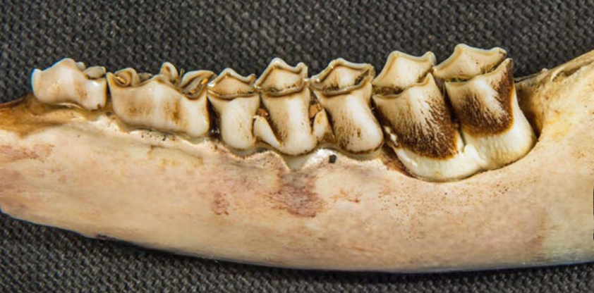
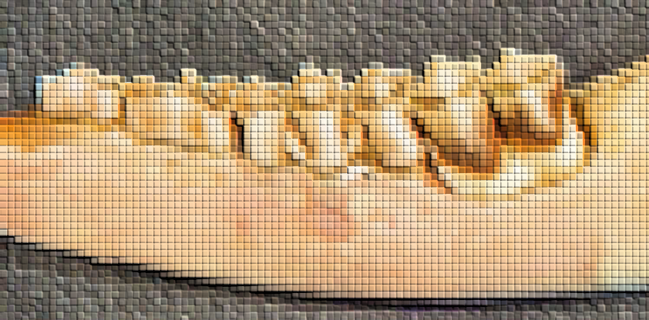
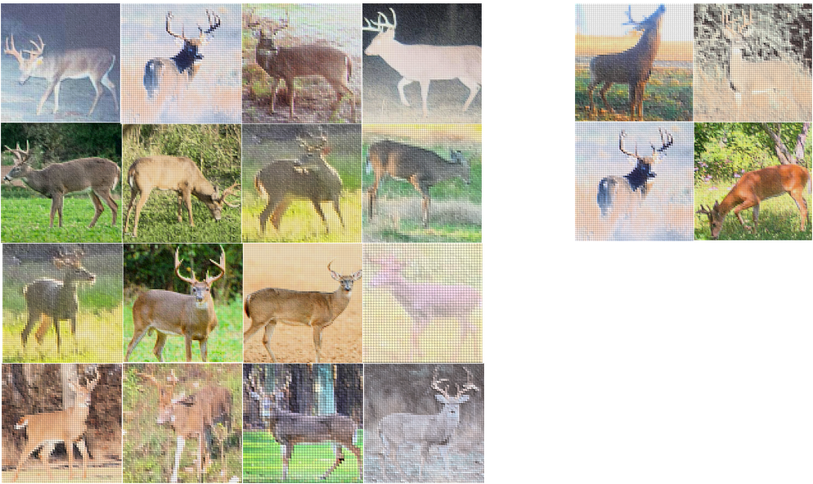

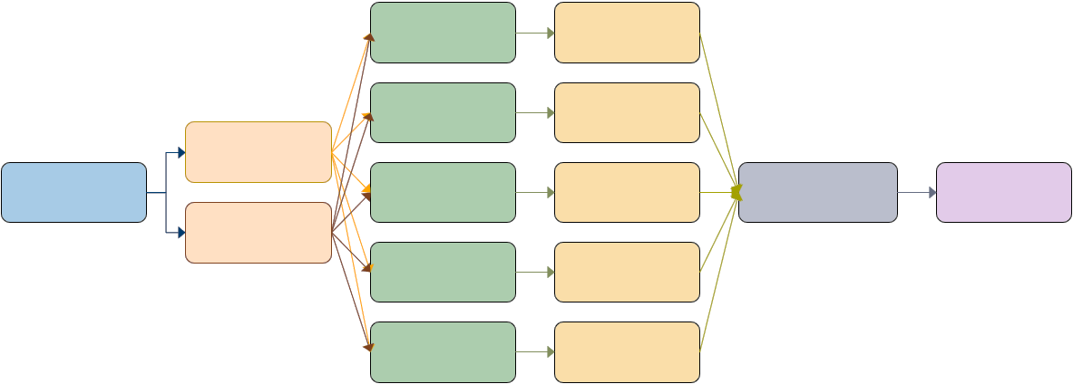


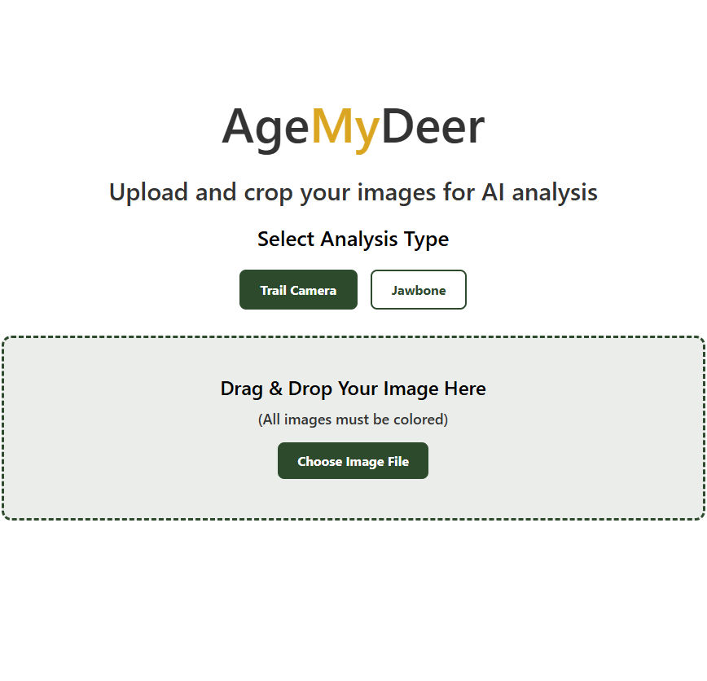

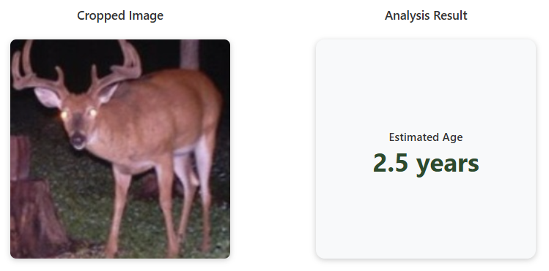
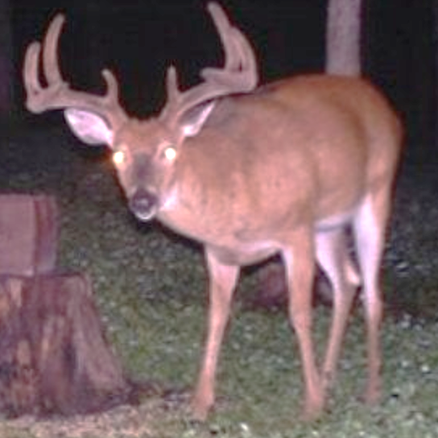
Workflow
Data collected through various sources
Resized images stored; info stored in metadata
Python collects, interpolates images
Optimal model stored on Dropbox (.pth)
Model developed
Dataset is split into training / validation set
Data input by user via website
Data transferred to model via Railway
Predictions returned to user via website

Slide 3
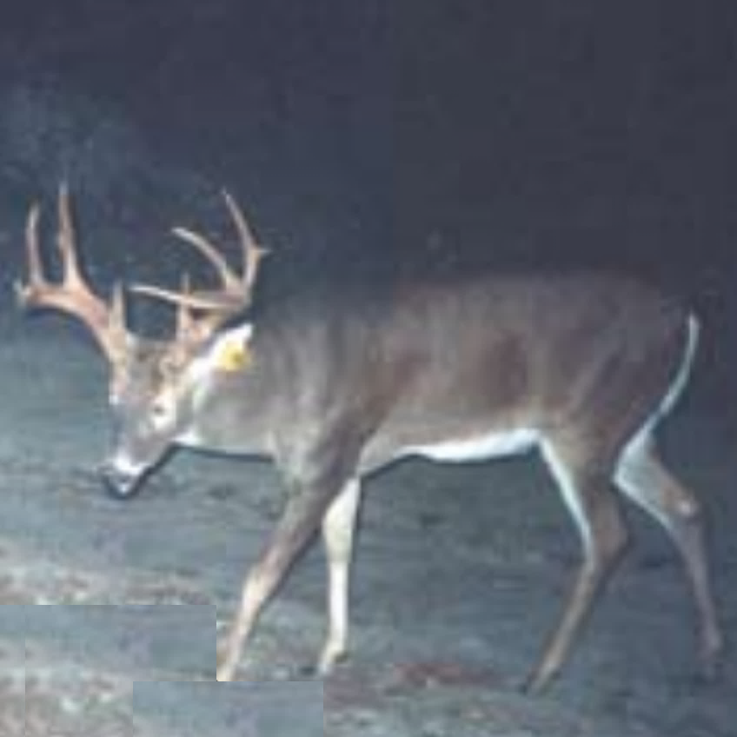
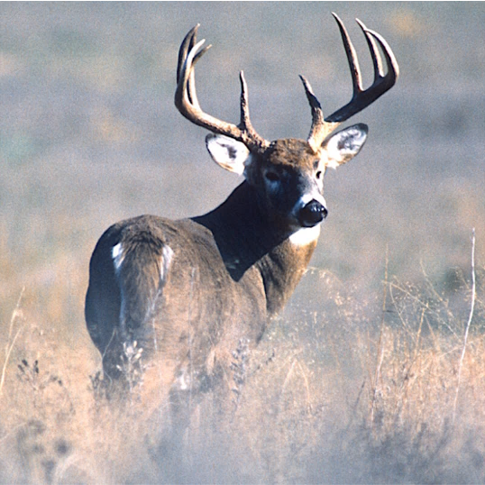
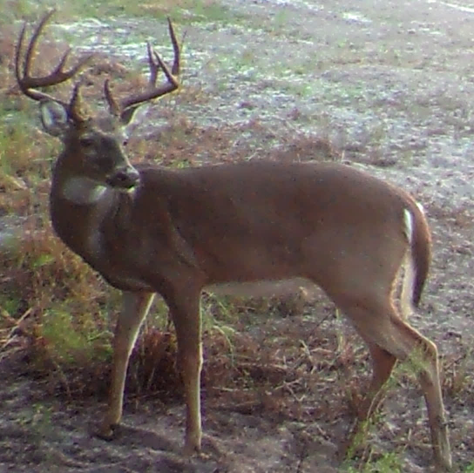
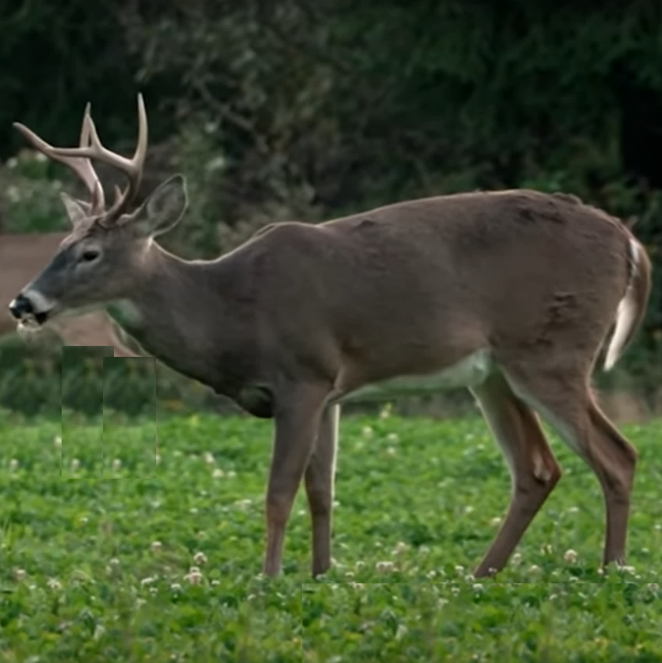
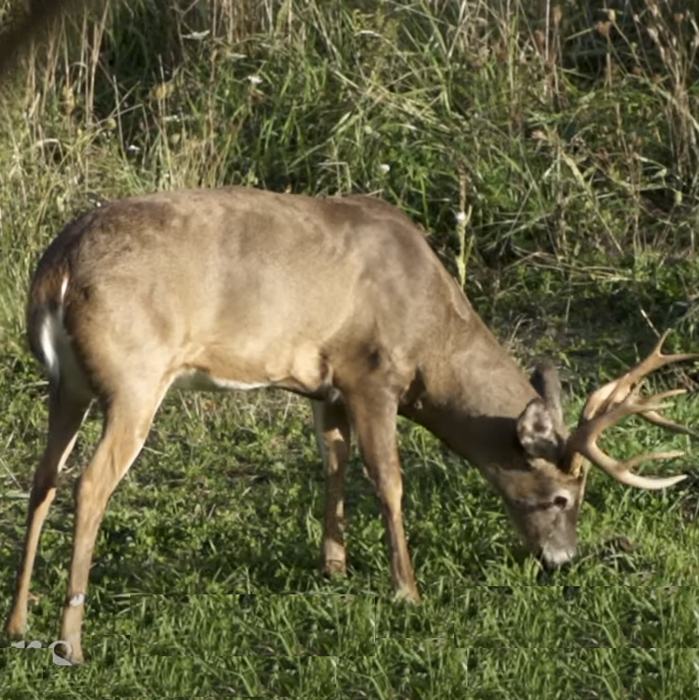
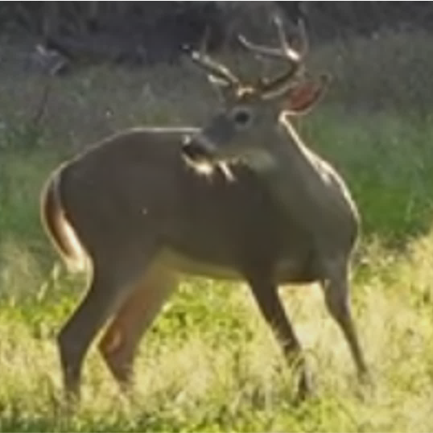
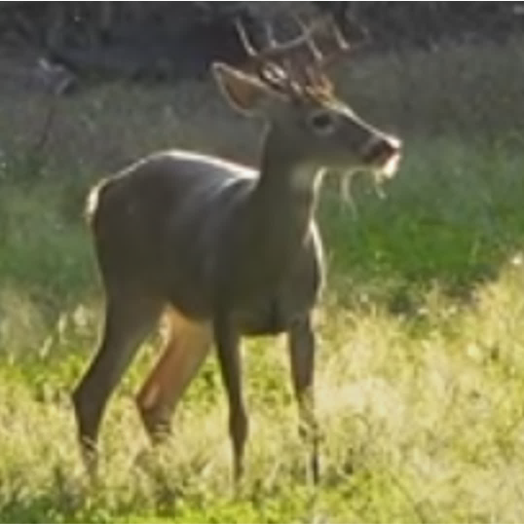
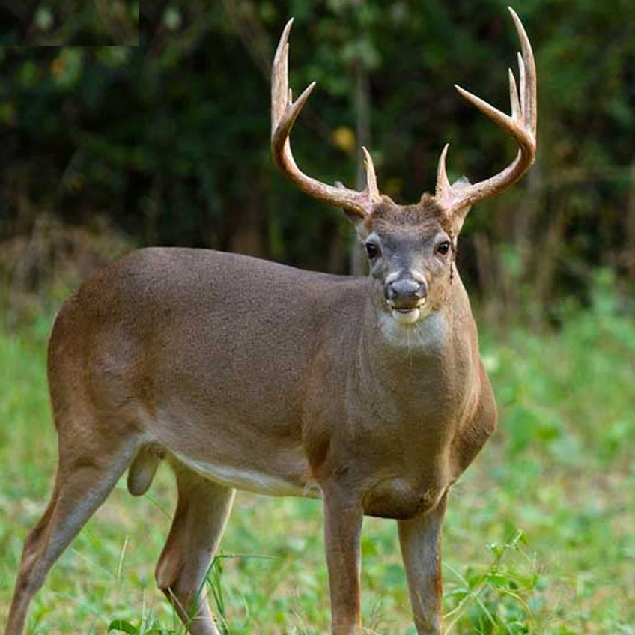
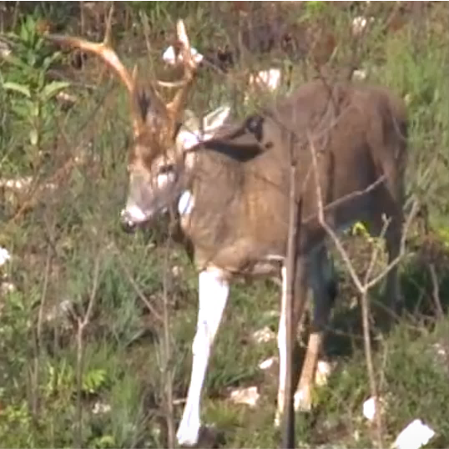
Data collection
Metadata
250202_230916_KY_3p5_NDA
Image recorded date (YY-MM-DD)
Image taken date
Image location (state)
Agency-determined age
Agency acronym
250116_241016_VA_2p5_NDA
240723_241107_KS_4p5_NDA
250202_230916_KY_3p5_NDA
250521_240909_WV_4p5_NDA
241219_241012_TX_3p5_NDA
250707_240918_WV_4p5_NDA
250603_241113_TX_3p5_NDA
250803_240708_IN_4p5_NDA
250906_250713_IN_3p5_NDA

Slide 4
Date | Model | Img size | Img type | Validation | Test | Metric | Filename
7/2/25 | Ensemble | 244 x 244 | Color | - | - | - | trailcam_ensemble
9/18/25 | EfficientNet-B5 | 512 x 512 | BW / Color | 80.4% | 78.4% | 0.63 | 251809_enb5

Slide 5
Extra images

Slide 6
ResNet-18
Model 1
Fold 1
Model 1 TTA (Original + Flip) → Avg. Prediction
ResNet-18
Model 2
Fold 2
Model 2 TTA (Original + Flip) → Avg. Prediction
Original image
Input
224 x 224 x 3
Deer image
ResNet-18
Model 3
Fold 3
Model 3 TTA (Original + Flip) → Avg. Prediction
Ensemble Agg.
SoftMax average
Final Prediction
Flipped image
ResNet-18
Model 4
Fold 4
Model 4 TTA (Original + Flip) → Avg. Prediction
ResNet-18
Model 5
Fold 5
Model 5 TTA (Original + Flip) → Avg. Prediction

Slide 7
